Slide 1

The most user-friendly platform for music lovers
Notes:
Page de garde proposition 2

Slide 2

Some users are not comfortable with listening to music online

Slide 3
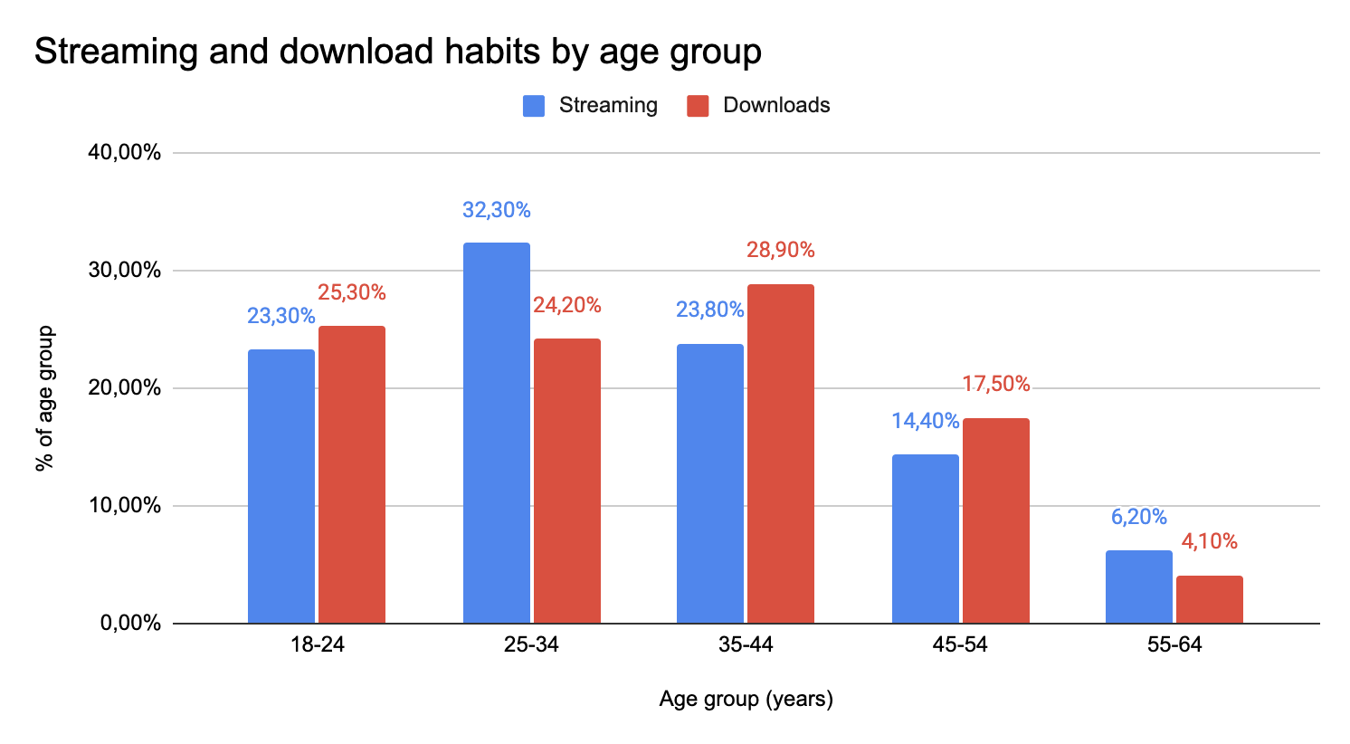
Nowadays, people aged 55-64 do not take advantage of streaming platforms

Slide 4
While using a streaming app has many drawbacks for some users, Vinyla appears as the most user friendly platform
Streaming apps pain points
user experience
Requires to download an app
Requires to create an account
Requires to pay to listen music or have adds
They need a simple and user-friendly interface at first glance.
No app : a simple web page
No account creation
Completely free service
the most easy to use music recommendation algorithm

Slide 5
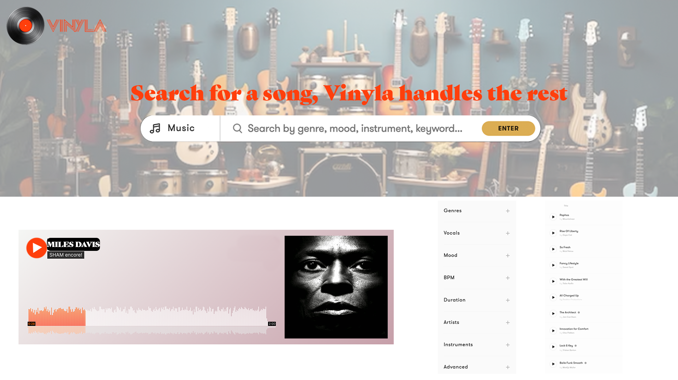

Slide 6





A very simple process to create a personalized playlist and discover your future favorite songs
One click confirmation of the song
The algorithm compares features with a database of 2000+ songs
1
2
3
4
5
The user inputs a song he likes
The algorithm analyses features of the song on 6 dimensions
A personalized playlist of 5 similar song is presented to the user
Legend:
Visible for the user
Background work

